Slide 1
Scalable Methods for Graph-Based Unsupervised and Semi-Supervised Learning
Frank Lin
PhD Thesis Oral ∙ July 24, 2012
Committee ∙ William W. Cohen ∙ Christos Faloutsos ∙ Tom Mitchell ∙ Xiaojin Zhu
Language Technologies Institute ∙ School of Computer Science ∙ Carnegie Mellon University

Slide 2
Motivation
Graph data is everywhere
We want to find interesting things from data
For non-graph data, it often makes sense to represent it as a graph
However, data can be big ☹

Slide 3
Thesis Goal
Make contributions toward fast, space-efficient, effective, simple graph-based learning methods that scale up.

Slide 4
Contributions
Power iteration clustering – scalable alternative to spectral clustering methods
MultiRankWalk – graph SSL, effective even with a few seeds
A framework/technique for extending iterative graph learning methods to non-graph data
ch2+3
PIC
icml 2010
ch4+5
MRW
asonam 2010
Important which instances are picked as seeds
ch6
Implicit
Manifolds
MRW Document and noun phrase categorization
via IM
PIC document clustering via IM
ch6.1
IM-PIC
ecai 2010
ch6.2
IM-MRW
mlg 2011
PIC mixed membership clustering via IM
Graph SSL with Gaussian kernel via approximate IM
ch7
MM-PIC
in submission
ch8
GK SSL
in submission
Clustering
Classification

Slide 5
Talk Path
ch2+3
PIC
icml 2010
ch4+5
MRW
asonam 2010
ch6
Implicit
Manifolds
ch6.1
IM-PIC
ecai 2010
ch6.2
IM-MRW
mlg 2011
ch7
MM-PIC
in submission
ch8
GK SSL
in submission
ch9
Future Work
Clustering
Classification

Slide 6
Talk Path
ch2+3
PIC
icml 2010
ch4+5
MRW
asonam 2010
ch6
Implicit
Manifolds
ch6.1
IM-PIC
ecai 2010
ch6.2
IM-MRW
mlg 2011
ch7
MM-PIC
in submission
ch8
GK SSL
in submission
ch9
Future Work
Clustering
Classification

Slide 7
Power Iteration Clustering
Spectral clustering methods are nice, a natural choice for graph data
But they are expensive (slow)
Power iteration clustering (PIC) can provide a similar solution at a very low cost (fast)! ☺

Slide 8
Background: Spectral Clustering
Normalized Cut algorithm (Shi & Malik 2000):
Choose k and similarity function s
Derive A from s, let W=I-D⁻¹A, where D is a diagonal matrix D_{(i,i)}=Σ_{j} A_{(i,j)}
Find eigenvectors and corresponding eigenvalues of W
Pick the k eigenvectors of W with the 2nd to k^{th} smallest corresponding eigenvalues
Project the data points onto the space spanned by these eigenvectors
Run k-means on the projected data points

Slide 9
Background: Spectral Clustering
datasets
cluster
1
2
3
clustering space
2nd smallest eigenvector
value
index
3rd smallest eigenvector

Slide 10
Background: Spectral Clustering
Can we find a similar low-dimensional embedding for clustering without eigenvectors?
Finding eigenvectors and eigenvalues of a matrix is slow in general
Normalized Cut algorithm (Shi & Malik 2000):
Choose k and similarity function s
Derive A from s, let W=I-D⁻¹A, where D is a diagonal matrix D_{(i,i)}=Σ_{j} A_{(i,j)}
Find eigenvectors and corresponding eigenvalues of W
Pick the k eigenvectors of W with the 2nd to k^{th} smallest corresponding eigenvalues
Project the data points onto the space spanned by these eigenvectors
Run k-means on the projected data points
There are more efficient approximation methods*
Note: the eigenvectors of I-D⁻¹A corresponding to the smallest eigenvalues are the eigenvectors of D⁻¹A corresponding to the largest

Slide 11
The Power Iteration
The power iteration is a simple iterative method for finding the dominant eigenvector of a matrix:
Typically converges quickly; fairly efficient if W is a sparse matrix
v^{t} : the vector at iteration t;
v⁰ typically a random vector
c : a normalizing constant to keep v^{t} from getting too large or too small
W : a square matrix

Slide 12
The Power Iteration
The power iteration is a simple iterative method for finding the dominant eigenvector of a matrix:
i.e., a row-normalized affinity matrix
What if we let W=D⁻¹A
(like Normalized Cut)?

Slide 13
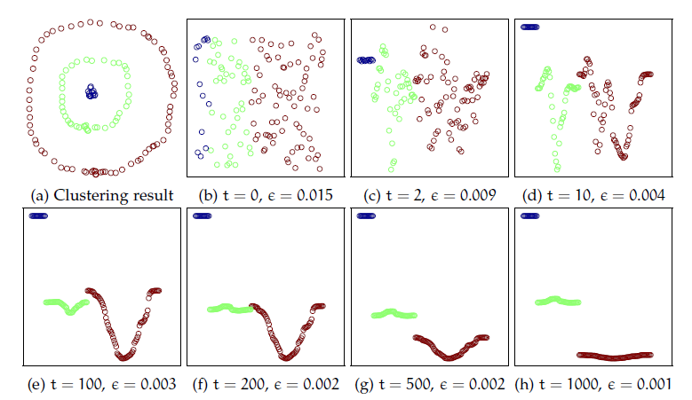
The Power Iteration
Begins with a random vector
Overall absolute distance between points decreases, here we show relative distance
Ends with a piece-wise constant vector!

Slide 14
Implication
We know: the 2nd to k^{th} eigenvectors of W=D⁻¹A are roughly piece-wise constant with respect to the underlying clusters, each separating a cluster from the rest of the data (Meila & Shi 2001)
Then: a linear combination of piece-wise constant vectors is also piece-wise constant!

Slide 15
Spectral Clustering
datasets
cluster
1
2
3
clustering space
2nd smallest eigenvector
value
index
3rd smallest eigenvector

Slide 16
Linear Combination…
a·
+
b·
=

Slide 17
Power Iteration Clustering
PIC results
v^{t}

Slide 18
Power Iteration Clustering
Key idea:
To do clustering, we may not need all the information in a full spectral embedding
(e.g., distance between clusters in a k-dimension eigenspace)
We just need the clusters to be separated in some space

Slide 19
When to Stop
At the beginning, v changes fast, “accelerating” to converge locally due to “noise terms” with small λ
The power iteration with its components:
If we normalize:
When “noise terms” have gone to zero, v changes slowly (“constant speed”) because only larger λ terms (2…k) are left, where the eigenvalue ratios are close to 1
Because they are raised to the power t, the eigenvalue ratios determines how fast v converges to e₁

Slide 20
Power Iteration Clustering
A basic power iteration clustering (PIC) algorithm:
Input: A row-normalized affinity matrix W and the number of clusters k
Output: Clusters C₁, C₂, …, C_{k}
Pick an initial vector v⁰
Repeat
  Set v^{t+1} ← Wv^{t}
  Set δ^{t+1} ← |v^{t+1} – v^{t}|
  Increment t
  Stop when |δ^{t} – δ^{t-1}| ≈ 0
Use k-means to cluster points on v^{t} and return clusters C₁, C₂, …, C_{k}

Slide 21
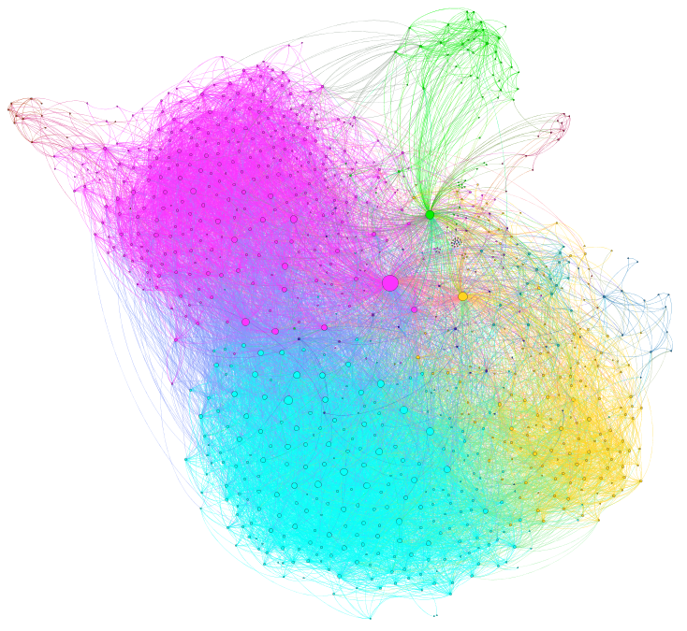
Evaluating Clustering for Network Datasets
Each dataset is an undirected, weighted, connected graph
Clusters are matched to classes using the Hungarian algorithm
Every node is labeled by human to belong to one of k classes
We use classification metrics such as accuracy, precision, recall, and F1 score; we also use clustering metrics such as purity and normalized mutual information (NMI)
Clustering methods are only given k and the input graph

Slide 22
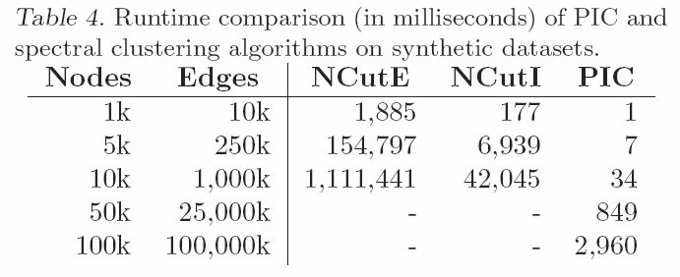
PIC Runtime
Normalized Cut, faster eigencomputation
Normalized Cut
Ran out of memory (24GB)

Slide 23
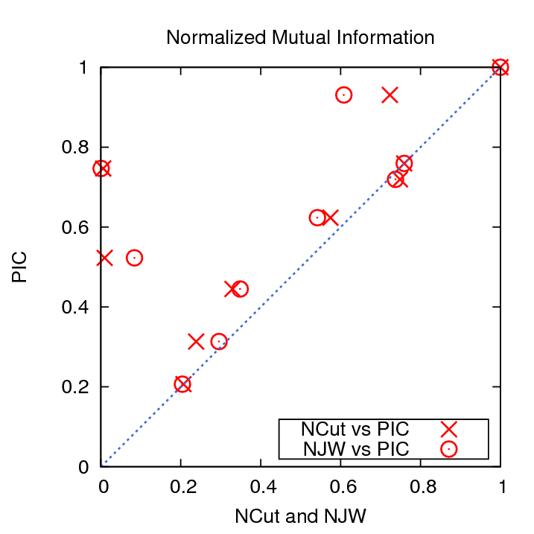
PIC Accuracy on Network Datasets
Upper triangle: PIC does better
Lower triangle: NCut or NJW does better

Slide 24
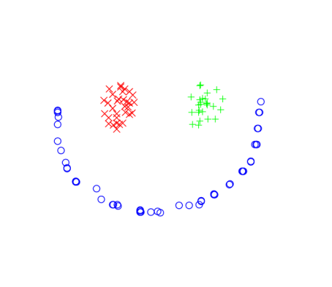



Multi-Dimensional PIC
One robustness question for vanilla PIC as data size and complexity grow:
How many (noisy) clusters can you fit in one dimension without them “colliding”?
Cluster signals cleanly separated
A little too close for comfort?

Slide 25
Multi-Dimensional PIC
Solution:
  Run PIC d times with different random starts and construct a d-dimension embedding
  Unlikely any pair of clusters collide on all d dimensions

Slide 26
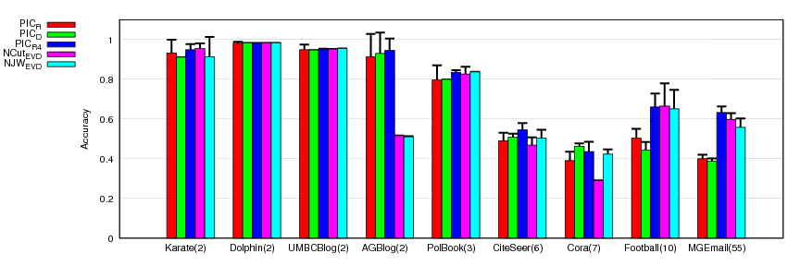
Multi-Dimensional PIC
1-D PIC embeddings lose on accuracy at higher k’s compared to NCut and NJW
Results on network classification datasets:
RED: PIC using 1 random start vector
GREEN: PIC using 1 degree start vector
BLUE: PIC using 4 random start vectors
(# of clusters)
But using a 4 random vectors instead helps!
Note # of vectors << k
Notes:
Line or scatter plot?

Slide 27
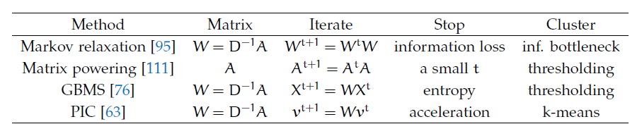
PIC Related Work
Related clustering methods:
PIC is the only one using a reduced dimensionality – a critical feature for graph data!

Slide 28
Talk Path
ch2+3
PIC
icml 2010
ch4+5
MRW
asonam 2010
ch6
Implicit
Manifolds
ch6.1
IM-PIC
ecai 2010
ch6.2
IM-MRW
mlg 2011
ch7
MM-PIC
in submission
ch8
GK SSL
in submission
ch9
Future Work
Clustering
Classification

Slide 29
MultiRankWalk
Classification labels are expensive to obtain
Semi-supervised learning (SSL) learns from labeled and unlabeled data for classification
For network data, what is a efficient and effective method that requires very few labels?
Our result: MultiRankWalk! ☺

Slide 30
Random Walk with Restart
Imagine a network, and starting at a specific node, you follow the edges randomly.
But with some probability, you “jump” back to the starting node (restart!).
If you recorded the number of times you land on each node, what would that distribution look like?

Slide 31
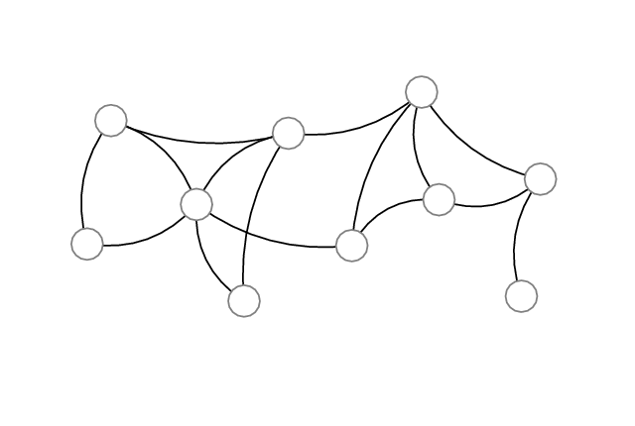
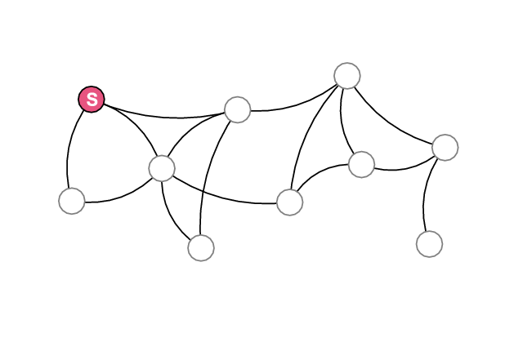
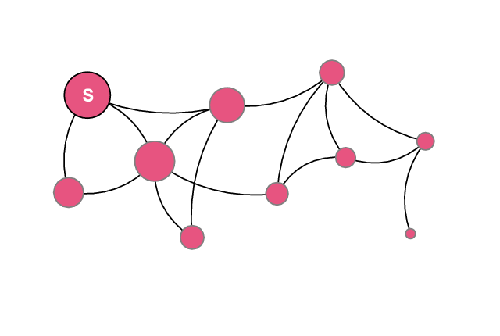
Random Walk with Restart
What if we start at a different node?
Start node

Slide 32
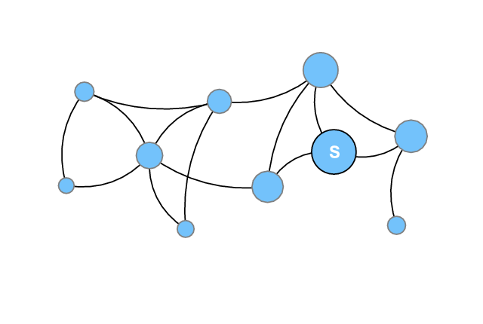
Random Walk with Restart
What if we start at a different node?

Slide 33
Random Walk with Restart
The walk distribution r satisfies a simple equation:
Start node(s)
Transition matrix of the network
Restart probability
“Keep-going” probability (damping factor)

Slide 34
Random Walk with Restart
Random walk with restart (RWR) can be solved simply and efficiently with an iterative procedure:

Slide 35
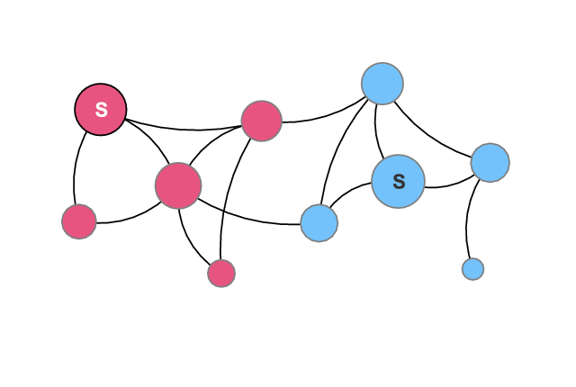
MRW: RWR for Classification
Simple idea: use RWR for classification
RWR with start nodes being labeled points in class A
RWR with start nodes being labeled points in class B
Nodes frequented more by RWR(A) belongs to class A, otherwise they belong to B

Slide 36
Evaluating SSL for Network Datasets
Each dataset is an undirected, weighted, connected graph
For every trial, all the non-seed instances are used as test data
Every node is labeled by human to belong to one of k classes
Evaluation metrics are accuracy, precision, recall, F1 score
We vary the amount of labeled training seed instances

Slide 37
Network Datasets for SSL Evaluation
5 network datasets
  3 political blog datasets
  2 paper citation datasets
Questions
  How well can graph SSL methods do with very few seed instances? (1 or 2 per class)
  How to pick seed instances?

Slide 38
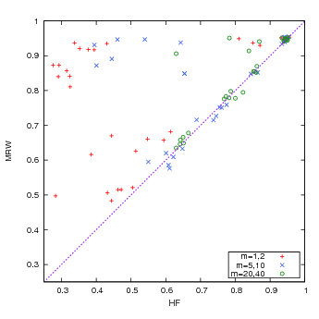
MRW Results
MRW does much better when only using a few seeds!
Accuracy: MRW vs. harmonic functions method (HF)
With lots of seeds, both methods do well
Upper triangle: MRW better
Lower triangle: HF better
legend:
+ a few seeds
× more seeds
○ lots of seeds

Slide 39
MRW: Seed Preference
Obtaining labels for data points is expensive
We want to minimize cost for obtaining labels
Observations:
  Some labels more “useful” than others as seeds
  Some labels easier to obtain than others
Question: “Authoritative” or “popular” nodes in a network are typically easier to obtain labels for. But are these labels also more useful than others as seeds?

Slide 40
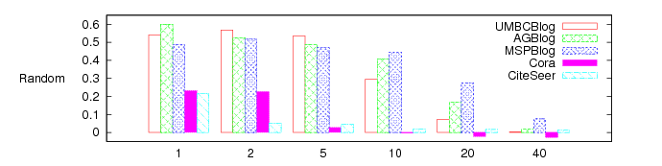
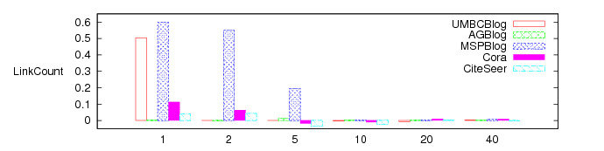
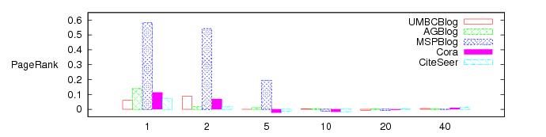
MRW Results
y-axis:
(MRW F1) – (HF F1)
Difference between MRW and HF using authoritative seed preference
Random:
MRW >> HF for low # seed
x-axis:
# seed labels per class
Gap between MRW and HF narrows with authoritative seeds on most datasets
PageRank seed preference works best!

Slide 41
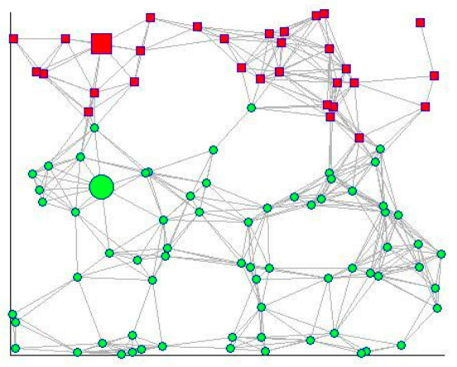
Big Picture: Graph-based SSL
Graph-based semi-supervised learning methods can often be viewed as methods for propagating labels along edges of a graph.
Many of them can be viewed in relation to Markov random walks
Labeled
class A
Label the rest via random walk propagation
Labeled
Class B

Slide 42
Two Families of Random Walk SSL
Backward random walk
(with Sink Nodes)
Forward random walk
(with restarts)
HF’s cousins:
Partially labeled classification using Markov random walks (Szummer & Jaakkola 2001)
Learning on diffusion maps (Lafon & Lee 2006)
The rendezvous algorithm (Azran 2007)
Weighted-voted relational network classifier (Macskassy & Provost 2007)
Adsorption (Baluja et al. 2008)
Weakly-supervised classification via random walks (Talukdar et al. 2008)
and many others…
MRW’s cousins:
Learning with local and global consistency [Variation 1] (Zhou et al. 2004)
Web content classification using link information (Gyongyi et al. 2006)
Graph-based SSL as a generative model (He et al. 2007)
and others …

Slide 43
Backward Random Walk w/ Sink Nodes
Sink node A
If I start walking randomly from this node, what are the chances that I’ll arrive in A (and stay there), versus B?
Sink node B
To compute, run random walk backwards from A and B
No inherent regulation of probability mass, but can ameliorate with heuristics such as class mass normalization
Related to hitting probabilities

Slide 44
Forward Random Walk w/ Restart
Random walker A starts (and restarts) here
What’s the probability of A being here at any point in time? How about B?
Random walker B starts (and restarts) here
To compute, run random walk forward, with restart,
from A and B
Inherent regulation of probability mass, but how to adjust it if we know a prior distribution?
The probability of the walker at a this node, given infinite time

Slide 45
Talk Path
ch2+3
PIC
icml 2010
ch4+5
MRW
asonam 2010
ch6
Implicit
Manifolds
ch6.1
IM-PIC
ecai 2010
ch6.2
IM-MRW
mlg 2011
ch7
MM-PIC
in submission
ch8
GK SSL
in submission
ch9
Future Work
Clustering
Classification

Slide 46
Implicit Manifolds
Graph learning methods such as PIC and MRW work well on graph data.
Can we use them on non-graph data? What about text documents?

Slide 47
The Problem with Text Data
Documents are often represented as feature vectors of words:
The importance of a Web page is an inherently subjective matter, which depends on the readers…
In this paper, we present Google, a prototype of a large-scale search engine which makes heavy use…
You're not cool just because you have a lot of followers on twitter, get over yourself…
cool | web | search | make | over | you
0 | 4 | 8 | 2 | 5 | 3
0 | 8 | 7 | 4 | 3 | 2
1 | 0 | 0 | 0 | 1 | 2

Slide 48
The Problem with Text Data
Feature vectors are often sparse
But similarity matrix is not!
Mostly non-zero - any two documents are likely to have a word in common
Mostly zeros - any document contains only a small fraction of the vocabulary
 | 27 | 125 | -
 | 23 | - | 125
 | - | 23 | 27
cool | web | search | make | over | you
0 | 4 | 8 | 2 | 5 | 3
0 | 8 | 7 | 4 | 3 | 2
1 | 0 | 0 | 0 | 1 | 2

Slide 49
The Problem with Text Data
A similarity matrix is the input to many graph learning methods, such as spectral clustering, PIC, MRW, adsorption, etc.
Too expensive! Does not scale up to big datasets!
O(n²) time to construct
 | 27 | 125 | -
 | 23 | - | 125
 | - | 23 | 27
O(n²) space to store
> O(n²) time to operate on

Slide 50
The Problem with Text Data
A lot of cool work has gone into how to do this…
Solutions:
  Make the matrix sparse
  Implicit Manifold
But this is what we’ll talk about!

Slide 51
The Problem with Text Data
We want to use the similarity matrix for clustering and semi-supervised classification, but without constructing or storing the similarity matrix.

Slide 52
Implicit Manifolds
What do you mean by…?
A pair-wise similarity matrix is a manifold under which the data points “reside”.
It is implicit because we never explicitly construct the manifold (pair-wise similarity), although the results we get are exactly the same as if we did.
Sounds too good. What’s the catch?

Slide 53
Implicit Manifolds
Two requirements for using implicit manifolds on general data:
  The core of the graph learning algorithm is matrix-vector multiplications
  The dense similarity matrix is a product of sparse matrices
As long as they are met, we can obtain the exact same results without ever constructing a similarity matrix!
Let’s take a look at some specific examples...

Slide 54
Implicit Manifolds
We have a fast clustering method – but there’s the W that requires O(n²) storage space and construction and operation time!
A basic power iteration clustering (PIC) algorithm:
Input: A row-normalized affinity matrix W and the number of clusters k
Output: Clusters C₁, C₂, …, C_{k}
Pick an initial vector v⁰
Repeat
  Set v^{t+1} ← Wv^{t}
  Set δ^{t+1} ← |v^{t+1} – v^{t}|
  Increment t
  Stop when |δ^{t} – δ^{t-1}| ≈ 0
Use k-means to cluster points on v^{t} and return clusters C₁, C₂, …, C_{k}
Key operation in PIC
Note: matrix-vector multiplication!

Slide 55
Implicit Manifolds
What about matrix-vector multiplication?
If we can decompose the matrix…
W
A
B
C
Then we arrive at the same solution doing a series of matrix-vector multiplications!
Why is this a good thing?

Slide 56
Implicit Manifolds
Example – inner product similarity:
W
D⁻¹
F
F^{T}
≈n?
Diagonal matrix that normalizes W so rows sum to 1
The original feature matrix
The feature matrix transposed
Storage: ≈n
Construction: given
Storage: ≈O(n)
Construction: given
Storage: just use F

Slide 57
Implicit Manifolds
Example – inner product similarity:
W
D⁻¹
F
F^{T}
How about a similarity function we actually use for text data?
Iteration update:
Construction: ≈O(n)
Storage:
≈O(n)
Operation:
≈O(n)

Slide 58
Implicit Manifolds
Diagonal cosine normalizer matrix
Example – cosine similarity:
Compact storage: don’t need a cosine normalized version of the feature vectors ☺
Iteration update:
Construction: ≈O(n)
Storage:
≈O(n)
Operation:
≈O(n)

Slide 59
A Framework
Implicit manifolds provide:
  A principled way to apply a class of graph learning methods to general data
  A framework on which researchers can develop and discover new methods (and recognizing old ones)
  A tool set – pick the combination that best fits your task, based on all the great work that has be done before

Slide 60


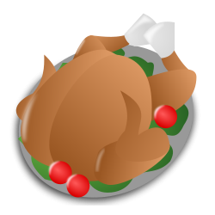

A Framework
How about MultiRankWalk with a low restart probability?
Hmm… I have a large dataset with very few training labels, what should I try?
Choose your SSL Method…
Harmonic Functions
MultiRankWalk

Slide 61



A Framework
Can’t go wrong with cosine similarity!
But the documents in my dataset are kinda long…
… and pick your similarity function
Inner Product
Cosine Similarity
Bipartite Graph Walk

Slide 62
Talk Path
ch2+3
PIC
icml 2010
ch4+5
MRW
asonam 2010
ch6
Implicit
Manifolds
ch6.1
IM-PIC
ecai 2010
ch6.2
IM-MRW
mlg 2011
ch7
MM-PIC
in submission
ch8
GK SSL
in submission
ch9
Future Work
Clustering
Classification

Slide 63
IM-PIC
Apply PIC using IM for document clustering:
Input: A row-normalized affinity matrix W and the number of clusters k
Output: Clusters C₁, C₂, …, C_{k}
Pick an initial vector v⁰
Repeat
  Set v^{t+1} ← D⁻¹(N(F(F^{T}(Nv^{t}))))
  Set δ^{t+1} ← |v^{t+1} – v^{t}|
  Increment t
  Stop when |δ^{t} – δ^{t-1}| ≈ 0
Use k-means to cluster points on v^{t} and return clusters C₁, C₂, …, C_{k}
Only modification: cosine IM

Slide 64
IM-PIC Experiment
The RCV1 document collection:
C
D
E
C
D
D
E
A
B
C
C
D
D
D
E
E
A
B
C
C
C
D
D
D
E
E
A
B
B
C
C
D
D
D
D
E
A
B
B
C
C
D
D
D
E
B
B
C
C
D
D
E
E
B
B
C
D
D
D
E
E
C
C
C
D
D
D
E
C
C
D
C
D
E
D
E
Pair of classes of comparable sizes
E
100 datasets total
Pair Dataset 1
Pair Dataset 2
Pair Dataset 3
C
C
D
D
D
E
E
E
D
D
D
C
C
C
D
D
E
E
D
D
A
D
C
C
D
D
E
E
E
D
D
A
D
C
D
D
D
E
D
D
D
A
D
C
C
C
D
D
D
E
D
D
D
A
D
C
C
C
D
E
E
D
D
C
C
D
E
E
E
D
D
E
D

Slide 65
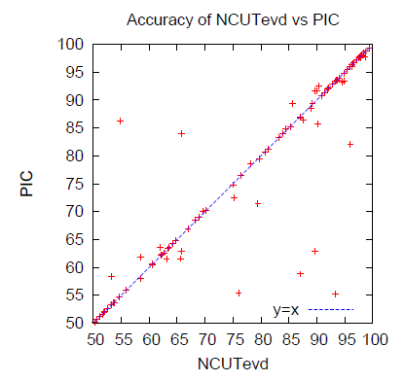
IM-PIC Result
Diagonal: tied (most datasets)
An accuracy result:
Upper triangle: PIC wins
No statistically significant difference – same accuracy
Each point is accuracy for a 2-cluster text dataset
Lower triangle: spectral clustering wins
Notes:
stick with one (accuracy or nmi)

Slide 66
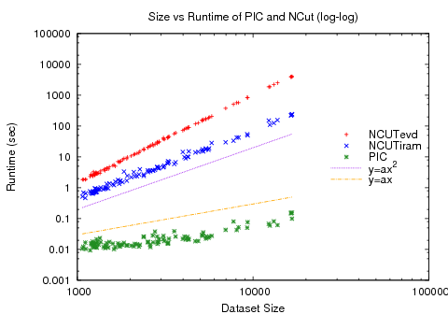
IM-PIC Result
y: algorithm runtime (log scale)
Spectral clustering (red & blue)
A scalability result:
Quadratic curve
Linear curve
x: data size (log scale)
Our method (green)

Slide 67
Talk Path
ch2+3
PIC
icml 2010
ch4+5
MRW
asonam 2010
ch6
Implicit
Manifolds
ch6.1
IM-PIC
ecai 2010
ch6.2
IM-MRW
mlg 2011
ch7
MM-PIC
in submission
ch8
GK SSL
in submission
ch9
Future Work
Clustering
Classification

Slide 68
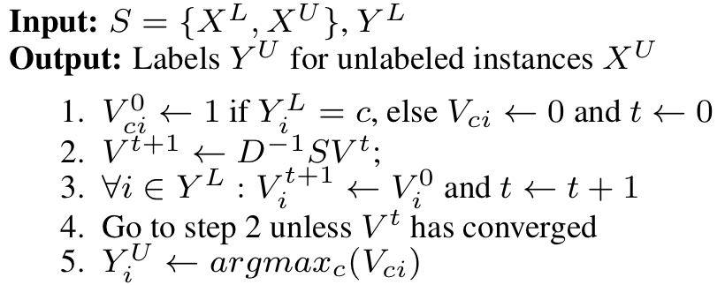
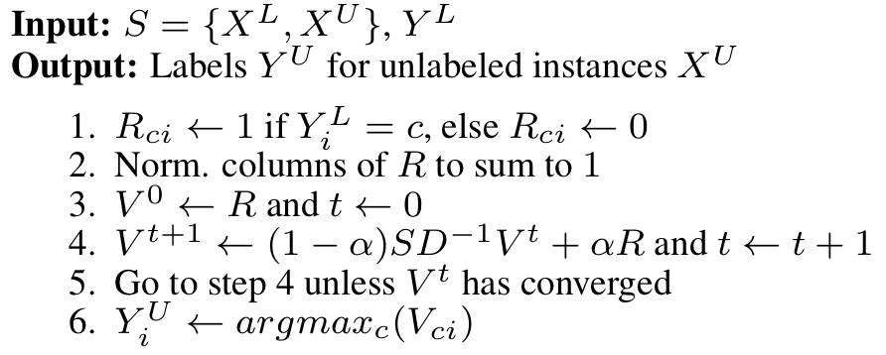
Applying IM to Graph SSL Methods
Harmonic functions method (HF) (it. impl)
MultiRankWalk (MRW)
In both of these iterative implementations, the core computation are matrix-vector multiplications!

Slide 69
IM-MRW Experiment
Task:
  document categorization
  noun-phrase categorization
Methods compared:
  Harmonic functions (HF)
  MultiRankWalk (MRW)
Similarity function (using implicit manifolds):
  inner product
  cosine similarity
  bipartite graph walk
HF + bipartite graph walk IM is equivalent to a version of co-EM, used in prior work also to categorize NPs!

Slide 70
IM-PIC Experiment
The RCV1 document collection:
C
D
E
C
D
D
E
A
B
C
C
D
D
D
E
E
A
B
C
C
C
D
D
D
E
E
A
B
B
C
C
D
D
D
D
E
A
B
B
C
C
D
D
D
E
B
B
C
C
D
D
E
E
B
B
C
D
D
D
E
E
C
C
C
D
D
D
E
C
C
D
C
D
E
D
E
E
103-class categorization data

Slide 71
Noun Phrase and Context Data
NP-context data:
… know that drinking pomegranate juice may not be a bad …
before context
NP
after context
Context: features
3
know that drinking _
pomegranate juice
2
_ may not be a bad
5
JELL-O
8
_ is made from
2
Jagermeister
1
_ promotes responsible
NP: instances

Slide 72
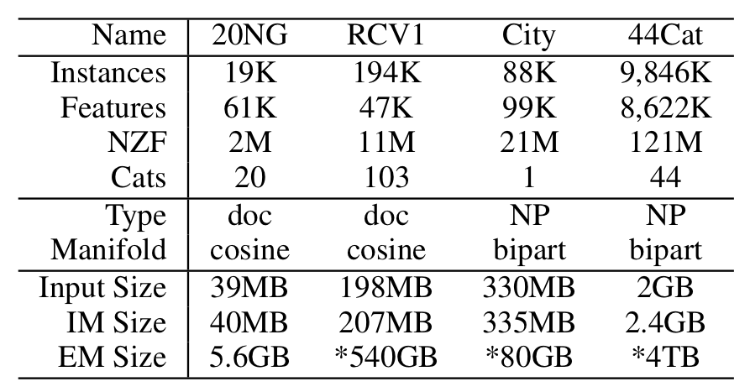
IM-MRW Datasets
Evaluation of NP datasets done using Mechanical Turk
2 document categorization datasets
2 NP classification datasets

Slide 73
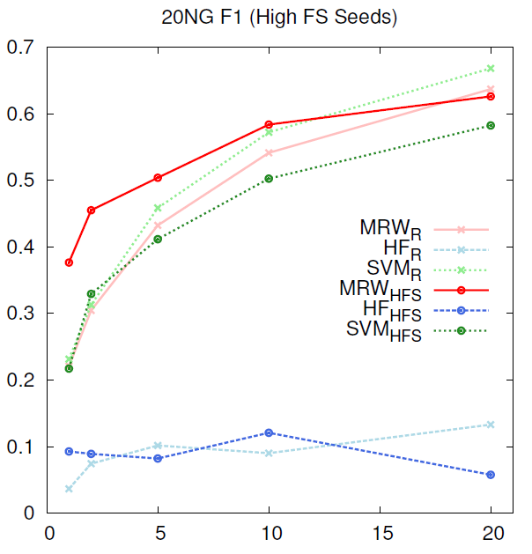
IM-MRW Result
20 newsgroups document categorization
y axis: F1 score
MRW better than SVM with few seeds, competitive with SVM with more seeds
Using authoritative seeds helps a lot when using a few seeds!
x axis: # seeds

Slide 74
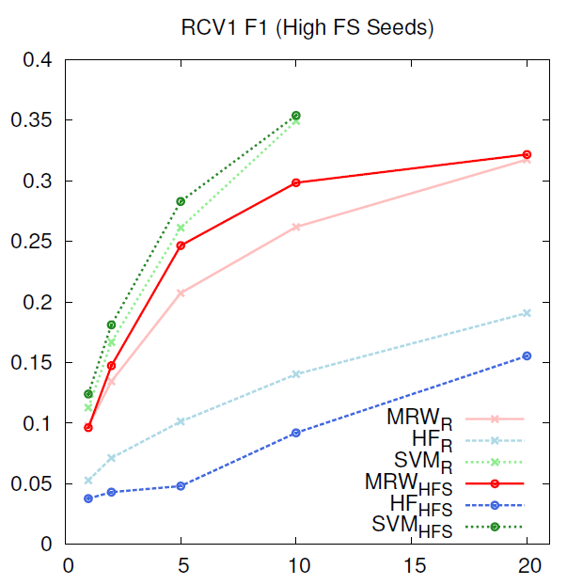
IM-MRW Result
RCV1 document categorization
SSL methods don’t always help – SVM outperforms both MRW & HF!
SSL methods more useful when feature vectors are very sparse

Slide 75
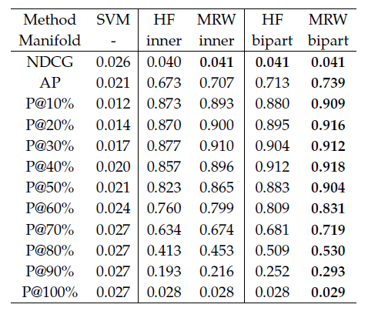
IM-MRW Result
MRW with bipart IM is best at every retrieval metric
City NP dataset:
Only 2 classes, city and non-city, so evaluate as a retrieval
task
Similarity function makes a difference:
HF-bipart is better than MRW-inner

Slide 76
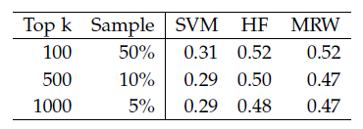
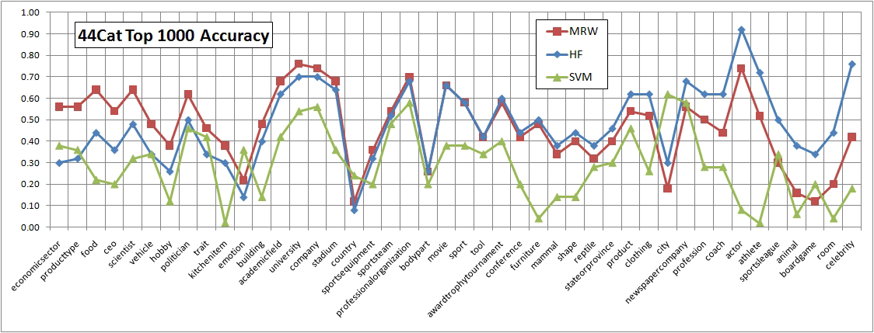
IM-MRW Result
Overall F1 difference between MRW and HF not stat. sig.
Dataset too large; sampled evaluation
44Cat NP dataset:
Difference methods do differently on different categories of NPs!

Slide 77
Talk Path
ch2+3
PIC
icml 2010
ch4+5
MRW
asonam 2010
ch6
Implicit
Manifolds
ch6.1
IM-PIC
ecai 2010
ch6.2
IM-MRW
mlg 2011
ch7
MM-PIC
in submission
ch8
GK SSL
in submission
ch9
Future Work
Clustering
Classification

Slide 78
Mixed Membership PIC
Clustering methods such as NCut and PIC assign each data point to only one cluster
However, sometimes single membership clustering may not be good enough....

Slide 79
MM-PIC

Slide 80
MM-PIC
How to do mixed membership clustering with graph partition methods like NCut and PIC?
Our solution: edge clustering!

Slide 81
Edge Clustering
Assumption:
  An edge represents relationship between two nodes
  A node can belong to multiple clusters, but an edge can only belong to one

Slide 82
Edge Clustering
Transform edges into nodes!
How to cluster edges?
Need a edge-centric view of the graph G
  Traditionally: a line graph L(G)
    Problem: potential (and likely) size blow up!
    size(L(G))=O(size(G)²)
  Our solution: a bipartite feature graph B(G)
    Space-efficient
    size(B(G))=O(size(G))
Side note: can also be used to represent tensors efficiently!
Notes:
animation

Slide 83
Edge Clustering
The original graph G
The line graph L(G)
BFG - the bipartite feature graph B(G)
a
ab
a
ab
b
ab
b
ac
ac
cb
ac
bc
c
c
bc
cb
ce
d
cd
d
e
cd
ce
e
ce
Costly for star-shaped structure!
Only use twice the space of G

Slide 84
Edge Clustering
A general recipe:
  Transform affinity matrix A into B(A)
  Run cluster method and get edge clustering
  For each node, determine mixed membership based on the membership of its incident edges
The matrix dimensions of B(A) is very big – can only use sparse methods on large datasets
Perfect for PIC and implicit manifolds!☺

Slide 85
MM-PIC Experiment
Compare:
  NCut
  Node-PIC (single membership)
  MM-PIC using different cluster label schemes:
    Max - pick the most frequent edge cluster (single membership)
    T@40 - pick edge clusters with at least 40% frequency
    T@20 - pick edge clusters with at least 20% frequency
    T@10 - pick edge clusters with at least 10% frequency
    All - use all incident edge clusters
?
1 cluster label
many labels

Slide 86
MM-PIC Experiment
Data source:
  BlogCat1
    10,312 blogs and links
    39 overlapping category labels
  BlogCat2
    88,784 blogs and link
    60 overlapping category labels
Datasets:
  Pick pairs of categories with enough overlap
  BlogCat1: 86 category pair datasets
  BlogCat2: 158 category pair datasets
Similar to the document clustering experiment

Slide 87
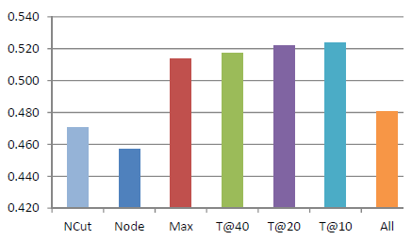
MM-PIC Result
F1 scores for clustering category pairs from the BlogCat1 dataset:
Generally a lower threshold is better, but not All
Max is better than Node!

Slide 88
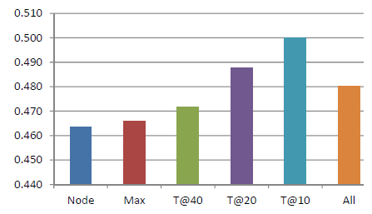
MM-PIC Result
F1 scores for clustering category pairs from the (bigger) BlogCat2 dataset:
More differences between thresholds
Did not use NCut because the datasets are too big...
Threshold matters!

Slide 89
Talk Path
ch2+3
PIC
icml 2010
ch4+5
MRW
asonam 2010
ch6
Implicit
Manifolds
ch6.1
IM-PIC
ecai 2010
ch6.2
IM-MRW
mlg 2011
ch7
MM-PIC
in submission
ch8
GK SSL
in submission
ch9
Future Work
Clustering
Classification

Slide 90

Random Walks on Continuous Spaces
Random walk learning methods such as PIC, MRW, and HF on network data and implicit manifolds assume discrete features....
What about continuous features?
Can we use implicit manifolds?

Slide 91
Implicit Manifolds
Discrete example – inner product similarity:
91

Slide 92
Implicit Manifolds
How about similarity functions for continuous spaces?
A favorite:
Results in a dense (full) similarity matrix S!
No easy way is known for decomposing it into sparse matrices.
The Gaussian kernel

Slide 93
IM for GKHS
Idea:
  Approximate the Gaussian kernel Hilbert space!
  Method 1: Use random Fourier basis
  Method 2: Use Taylor expansion
Proposed for SVM
(Rahimi & Recht 2007)
Proposed for SVM (Cotter et al. 2011)
Discussion omitted for the sake of time (slides available)

Slide 94
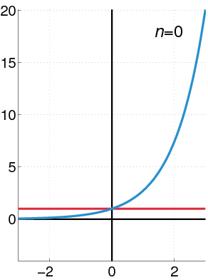
Taylor Expansion IM
Use Taylor expansion of the exponential function to approximate GK:
Note error greater further away from the point of approximation!

Slide 95

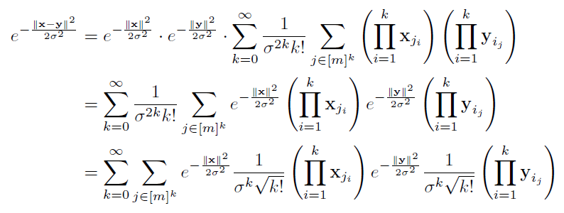
Taylor Expansion IM
Do Taylor expansion (vector version)
IM-compatible
inner product
depends on x
depends on y

Slide 96
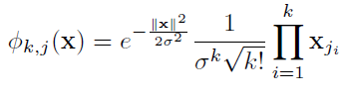
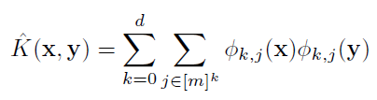
Taylor Expansion IM
Infinite long vector of “Taylor features”
Finally:
Use a low-order approximation for the infinite expansion:
Final representation

Slide 97
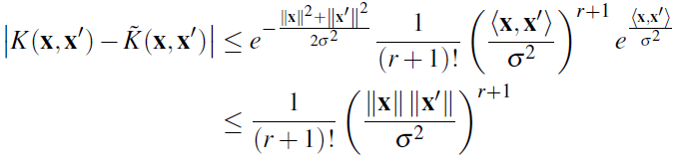


Taylor Expansion IM
Bad for points far away from origin
Error:
# of features per data point:
Feature construction time:
(Cotter et al. 2011)
Larger σ is better for approximation
Good for continuous data with sparse features or low dimensionality

Slide 98
Synthetic Data Experiment
Three kinds of spatial datasets:

Slide 99
Synthetic Data Result
Most manifolds do well; COS not as well as RF or TF
COS = cosine similarity
RF = random Fourier
TF = Taylor features
GK = full Gaussian kernel
X axis:
# seeds
Y axis: F1 score

Slide 100
Synthetic Data Result
SVM does well because of linearly separability
Both RF and TF work well while COS fails because it’s not rotation-invariant

Slide 101
Synthetic Data Result
Only TF works on this difficult dataset; RF did not work

Slide 102
GeoText Data
  GeoText geo-lexical region classification task (Eisenstein et al. 2010):
  Locations and a week’s worth of Twitter posts from 9,256 users
  Given text of posts, predict user location
Random walk learning:
  A combination of text and geolocation data
    Walk from users to other users using location similarity
    Walk from users to other users using text similarity

Slide 103
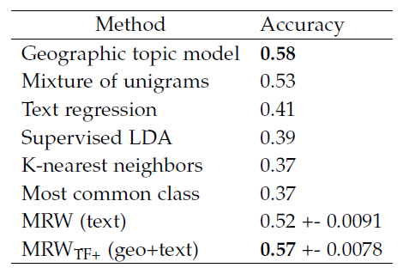
GeoText Data Result
GeoText data region classification task:
State-of-the-art topic model classifier; does more than region classification
Takes roughly a day to train model
Competitive with Geographic topic model
Takes 0.12 seconds

Slide 104
Talk Path
ch2+3
PIC
icml 2010
ch4+5
MRW
asonam 2010
ch6
Implicit
Manifolds
ch6.1
IM-PIC
ecai 2010
ch6.2
IM-MRW
mlg 2011
ch7
MM-PIC
in submission
ch8
GK SSL
in submission
ch9
Future Work
Clustering
Classification

Slide 105
Future Work
PIC Extensions
ch2+3
PIC
icml 2010
ch4+5
MRW
asonam 2010
ch6
Implicit
Manifolds
ch6.1
IM-PIC
ecai 2010
ch6.2
IM-MRW
mlg 2011
ch7
MM-PIC
in submission
ch8
GK SSL
in submission
Clustering
Classification

Slide 106
Future Work
PIC Extensions
ch2+3
PIC
icml 2010
ch4+5
MRW
asonam 2010
Data Visual.
ch6
Implicit
Manifolds
ch6.1
IM-PIC
ecai 2010
ch6.2
IM-MRW
mlg 2011
ch7
MM-PIC
in submission
ch8
GK SSL
in submission
Clustering
Classification

Slide 107
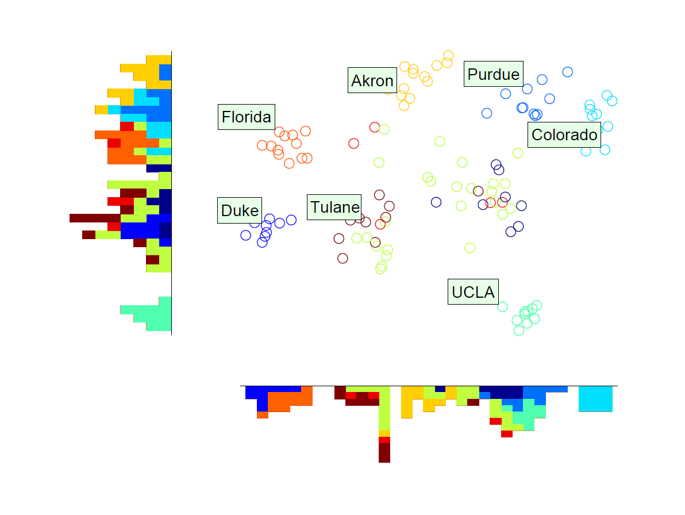
Data Visualization
Overlapping nodes...

Slide 108
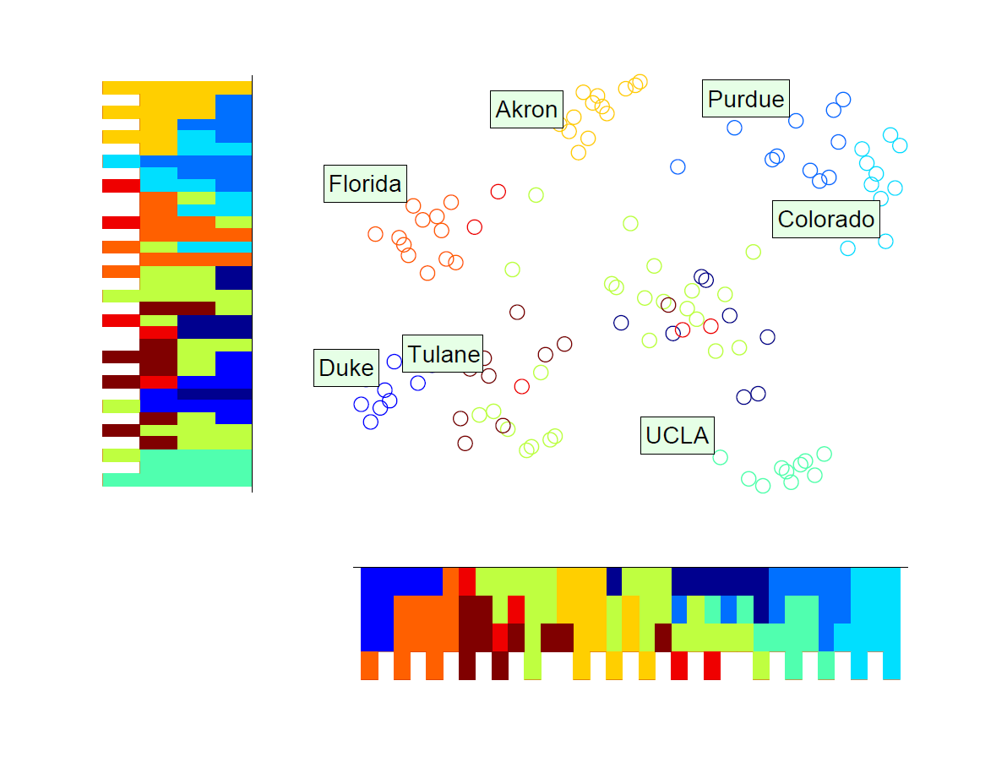
Data Visualization
Can be spread out easily
Histogram indicates a cleaner 2D visualization

Slide 109
Future Work
PIC Extensions
ch2+3
PIC
icml 2010
ch4+5
MRW
asonam 2010
Data Visual.
ch6
Implicit
Manifolds
Interactive
PIC
ch6.1
IM-PIC
ecai 2010
ch6.2
IM-MRW
mlg 2011
ch7
MM-PIC
in submission
ch8
GK SSL
in submission
Clustering
Classification

Slide 110
Future Work
PIC Extensions
ch2+3
PIC
icml 2010
ch4+5
MRW
asonam 2010
Data Visual.
ch6
Implicit
Manifolds
Interactive
PIC
ch6.1
IM-PIC
ecai 2010
ch6.2
IM-MRW
mlg 2011
Learn Edge Weights
ch7
MM-PIC
in submission
ch8
GK SSL
in submission
Clustering
Classification

Slide 111

Learning Edge Weights for PIC
Learning via constraints:
  must-link (should be in the same cluster)
  cannot-link (should not be in the same cluster)
Objective:
Must-links
Cannot-links

Slide 112
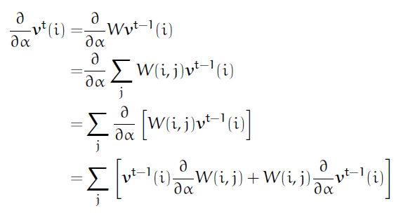
Learning Edge Weights for PIC
Recursive gradient:
Can be efficiently computed, in a way similar to power iteration
Recursion

Slide 113
Future Work
PIC Extensions
ch2+3
PIC
icml 2010
ch4+5
MRW
asonam 2010
Data Visual.
ch6
Implicit
Manifolds
Interactive
PIC
ch6.1
IM-PIC
ecai 2010
ch6.2
IM-MRW
mlg 2011
Learn Edge Weights
Other Kernels for SSL
ch7
MM-PIC
in submission
ch8
GK SSL
in submission
Clustering
Classification

Slide 114
Future Work
PIC Extensions
ch2+3
PIC
icml 2010
ch4+5
MRW
asonam 2010
Data Visual.
ch6
Implicit
Manifolds
Sampling RW SSL
Interactive
PIC
ch6.1
IM-PIC
ecai 2010
ch6.2
IM-MRW
mlg 2011
Learn Edge Weights
Other Kernels for SSL
ch7
MM-PIC
in submission
ch8
GK SSL
in submission
Clustering
Classification

Slide 115
Future Work
PIC Extensions
ch2+3
PIC
icml 2010
ch4+5
MRW
asonam 2010
Data Visual.
ch6
Implicit
Manifolds
Sampling RW SSL
Interactive
PIC
ch6.1
IM-PIC
ecai 2010
ch6.2
IM-MRW
mlg 2011
Learn Edge Weights
Other Kernels for SSL
ch7
MM-PIC
in submission
ch8
GK SSL
in submission
k-Walks
Clustering
Classification

Slide 116
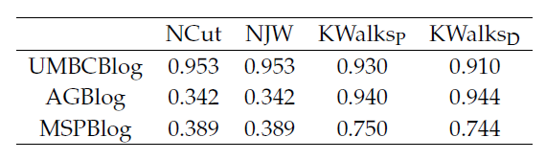
k-Walks
Preliminary results on blog datasets:
Better than PIC!

Slide 117
Talk Path
ch2+3
PIC
icml 2010
ch4+5
MRW
asonam 2010
ch6
Implicit
Manifolds
ch6.1
IM-PIC
ecai 2010
ch6.2
IM-MRW
mlg 2011
ch7
MM-PIC
in submission
ch8
GK SSL
in submission
ch9
Future Work
Clustering
Classification

Slide 118
Questions
?
ch2+3
PIC
icml 2010
ch4+5
MRW
asonam 2010
ch6
Implicit
Manifolds
ch6.1
IM-PIC
ecai 2010
ch6.2
IM-MRW
mlg 2011
ch7
MM-PIC
in submission
ch8
GK SSL
in submission
ch9
Future Work
Clustering
Classification

Slide 119
Additional Slides
+

Slide 120
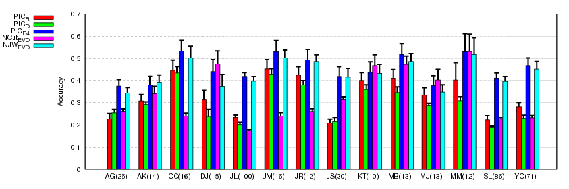
Multi-Dimensional PIC
Results on name disambiguation datasets:
Again using a 4 random vectors seems to work!
Again note # of vectors << k

Slide 121
PIC: Versus Popular Fast Sparse Eigencomputation Methods
Randomized sampling methods are also popular
For Symmetric Matrices | For General Matrices | Improvement
 | Successive Power Method | Basic; numerically unstable, can be slow
Lanczos Method | Arnoldi Method | More stable, but require lots of memory
Implicitly Restarted Lanczos Method (IRLM) | Implicitly Restarted Arnoldi Method (IRAM) | More memory-efficient
Method | Time | Space
IRAM | (O(m³)+(O(nm)+O(e))×O(m-k))×(# restart) | O(e)+O(nm)
PIC | O(e)x(# iterations) | O(e)

Slide 122
MRW: Seed Preference
Consider the task of giving a human expert (or posting jobs on Amazon Mechanical Turk) a list of data points to label
The list (seeds) can be generated uniformly at random, or we can have a seed preference, according to simple properties of the unlabeled data
We consider 3 preferences:
  Random
  Link Count
  PageRank
Nodes with highest counts make the list
Nodes with highest scores make the list

Slide 123
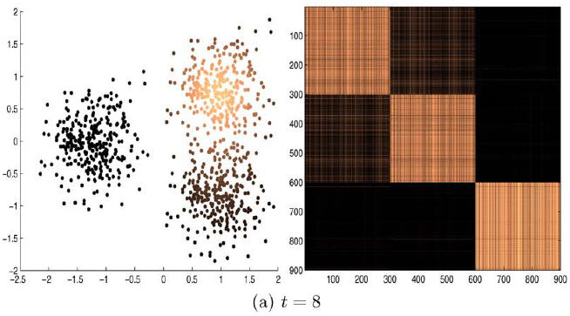
PIC: Another View
PIC’s low-dimensional embedding, which we will call a power iteration embedding (PIE), is related to diffusion maps:
(Coifman & Lafon 2006)

Slide 124
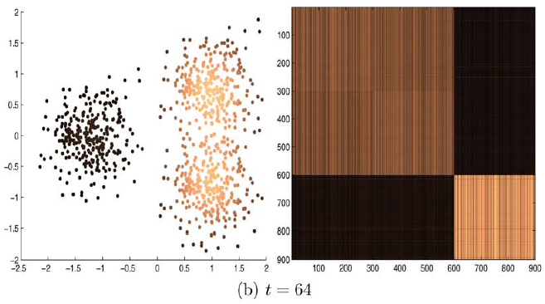
PIC: Another View
PIC’s low-dimensional embedding, which we will call a power iteration embedding (PIE), is related to diffusion maps:
(Coifman & Lafon 2006)

Slide 125
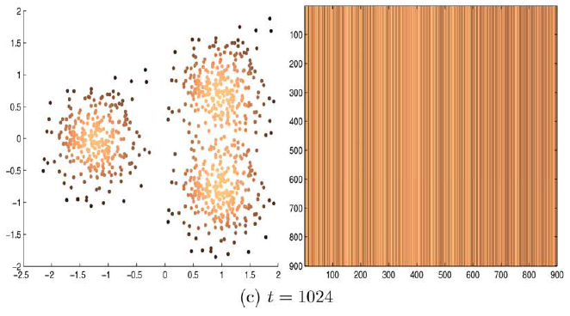
PIC: Another View
PIC’s low-dimensional embedding, which we will call a power iteration embedding (PIE), is related to diffusion maps:
(Coifman & Lafon 2006)

Slide 126
PIC: Another View
We can also use results from random projection for applying PIC!
Result:
PIE is a random projection of the data in the diffusion space W with scale parameter t
We can use results from diffusion maps for applying PIC!

Slide 127
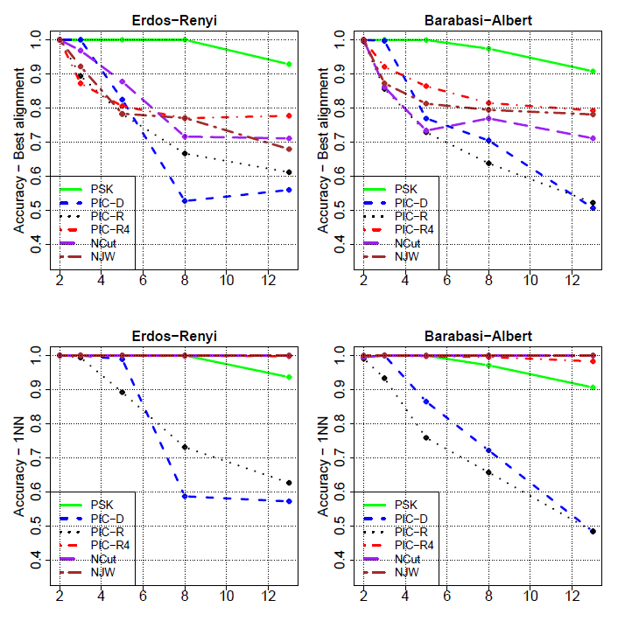
PIC on Synthetic Data (var. # cluster)

Slide 128
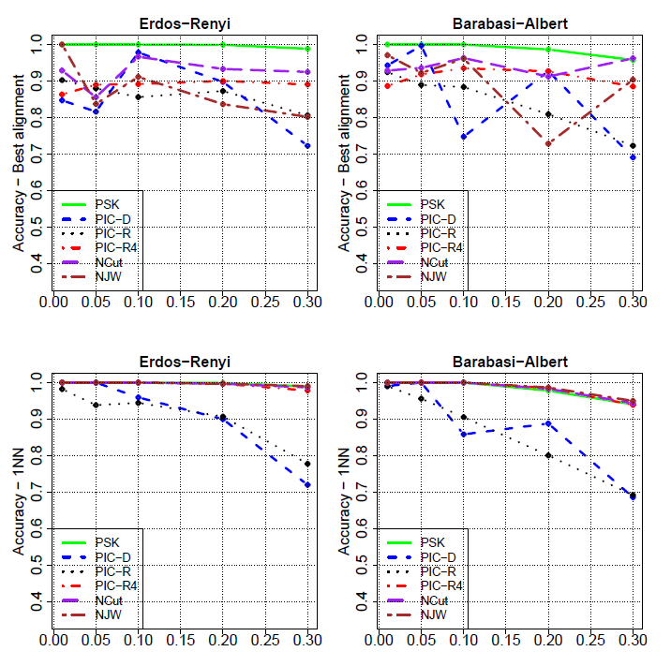
PIC on Synthetic Data (var. noise)

Slide 129
PIC Extension: Hierarchical Clustering
Real, large-scale data may not have a “flat” clustering structure
A hierarchical view may be more useful
Good News:
The dynamics of a PIC embedding display a hierarchically convergent behavior!

Slide 130
PIC Extension: Hierarchical Clustering
Why?
Recall PIC embedding at time t:
e’s – eigenvectors (structure)
Big
Small
More salient structure stick around
There may not be a clear eigengap - a gradient of cluster saliency
Less significant eigenvectors / structures go away first, one by one

Slide 131




PIC Extension: Hierarchical Clustering
Similar behavior also noted in matrix-matrix power methods (diffusion maps, mean-shift, multi-resolution spectral clustering)
Same dataset you’ve seen
PIC already converged to 8 clusters…
But let’s keep on iterating…
“N” still a part of the “2009” cluster…
Yes
(it might take a while)

Slide 132




Distributed / Parallel Implementations
Distributed / parallel implementations of learning methods are necessary to support large-scale data given the direction of hardware development
PIC, MRW, and their path folding variants have at their core sparse matrix-vector multiplications
Sparse matrix-vector multiplication lends itself well to a distributed / parallel computing framework
We propose to use
Alternatives:
Existing graph analysis tool:

Slide 133
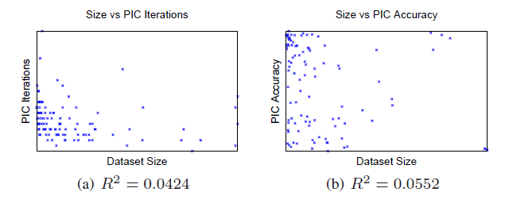
IM-PIC Result
PIC is O(n) per iteration and the runtime curve looks linear…
But I don’t like eyeballing curves, and perhaps the number of iteration increases with size or difficulty of the dataset?
Correlation plot
Correlation statistic
(0=none, 1=correlated)
Notes:
cut, backup slide for NCut vs PIC cluster similarity

Slide 134
Adjacency Matrix vs. Similarity Matrix
Adjacency matrix:
Similarity matrix:
Eigenanalysis:
What about the normalized versions?
Same eigenvectors and same ordering of eigenvalues!

Slide 135
Adjacency Matrix vs. Similarity Matrix
Normalized adjacency matrix:
Normalized similarity matrix:
Eigenanalysis:
Recent work on degree-corrected Laplacian (Chaudhuri 2012) suggests that it is advantageous to tune α for clustering graphs with a skewed degree distribution and does further analysis
Eigenvectors the same if degree is the same

Slide 136

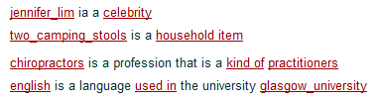
A Web-Scale Knowledge Base
Read the Web (RtW) project:
Build a never-ending system that learns to extract information from unstructured web pages, resulting in a knowledge base of structured information.

Slide 137
Noun Phrase and Context Data
As a part of RtW project, two kinds of noun phrase (NP) and context co-occurrence data was produced:
  NP-context co-occurrence data
  NP-NP co-occurrence data
These datasets can be treated as graphs

Slide 138
Noun Phrase and Context Data
NP-context data:
… know that drinking pomegranate juice may not be a bad …
before context
NP
after context
3
know that drinking _
pomegranate juice
2
_ may not be a bad
5
JELL-O
8
_ is made from
2
Jagermeister
1
NP-context
graph
_ promotes responsible

Slide 139
Noun Phrase and Context Data
Context can be used for weighting edges or making a more complex graph
NP-NP data:
… French Constitution Council validates burqa ban …
NP
context
NP
veil
French Constitution Council
burqa ban
French Court
hot pants
NP-NP
graph
Jagermeister
JELL-O

Slide 140
Random Walks on Graphs
Ranking
  PageRank (Page et al. 1999)
  HITS (Kleinberg 1999)
  ...
Semi-supervised Learning
  Harmonic functions (Zhu et al. 2003)
  Local and global consistency (Zhou et al. 2004)
  wvRN (Macskassy 2007)
  Adsorption (Talukdar et al. 2008)
  MultiRankWak (Lin et al. 2010)
  ...
Clustering
  k-walks (Lin et al. 2009)
  Power Iteration Clustering (Lin et al. 2010)

Slide 141
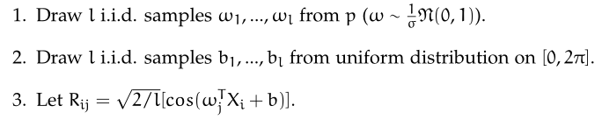
Random Fourier IM
Generate random Fourier features:
Then RR^{T} yields a similarity matrix that approximate a GK manifold!

Slide 142
Random Fourier IM

Slide 143
Random Fourier IM
1. Draw a line from the origin in a random direction

Slide 144
Random Fourier IM
bandwidth
2. Draw a random Fourier bandwidth according to σ

Slide 145
Random Fourier IM
3. “Slide” the cosine function by a random amount

Slide 146
Random Fourier IM
4. Project points

Slide 147
Random Fourier IM
5. Repeat

Slide 148

Random Fourier IM
Bad for points far away from origin
Error:
# of features per data point:
  The number of random Fourier projections
Feature construction time:
  The number of random Fourier projections
(Rahimi & Recht 2008)

Slide 149
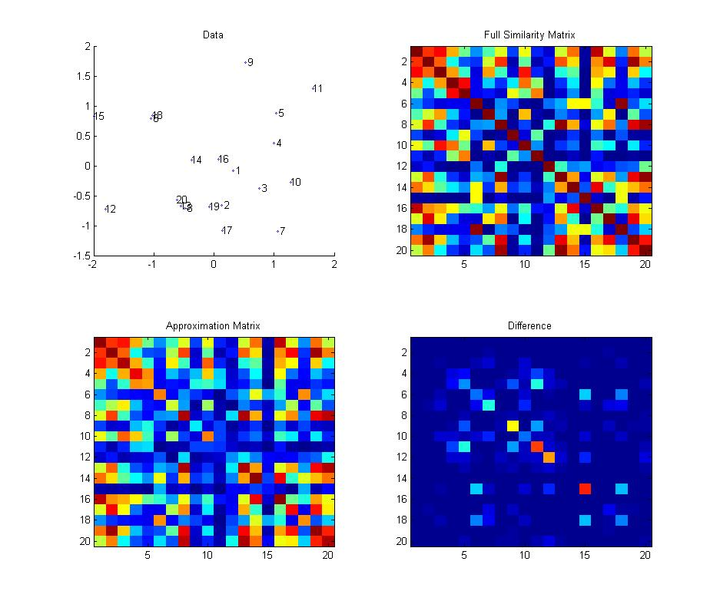
Taylor Feature GKHS
Space comparison (σ=1,d=2):

Slide 150

Taylor Feature GKHS
Space comparison (σ=1,d=3):

Slide 151

Taylor Feature GKHS
Space comparison (σ=1,d=4):

Slide 152

Taylor Feature GKHS
Space comparison (σ=1,d=5):

Slide 153

Taylor Feature GKHS
Space comparison (σ=1,d=6):

Slide 154
Taylor Feature GKHS
Space comparison (σ=1,d=3):

Slide 155

Taylor Feature GKHS
Space comparison (σ=2,d=3):

Slide 156

Taylor Feature GKHS
Space comparison (σ=3,d=3):

Slide 157

Taylor Feature GKHS
Space comparison (σ=4,d=3):

Slide 158
Full Synthetic Data Result

Slide 159
Full Synthetic Data Result

Slide 160
Full Synthetic Data Result

Slide 161
MRW: Basic Questions
Settings where you need personalized, low-overhead labeling (e.g., experience with SpamBayes)
Many HF-style methods basically produce the same results
MRW-style produce quite different results, yet not used much at all for SSL classification (mostly for retrieval); as a variation of a general regularization, also as a feature in web site categorization
No comparison
Nagging questions
General framework, learning parameters for:
  D^{-1/2}AD^{-1/2}, D⁻¹A, AD⁻¹

Slide 162
Template
ch2+3
PIC
icml 2010
ch4+5
MRW
asonam 2010
ch6
Implicit
Manifolds
ch6.1
IM-PIC
ecai 2010
ch6.2
IM-MRW
mlg 2011
ch7
MM-PIC
in submission
ch8
GK SSL
in submission
Clustering
Classification

Slide 163
Relation
ch2+3
PIC
icml 2010
ch4+5
MRW
asonam 2010
ch6
Implicit
Manifolds
ch6.1
IM-PIC
ecai 2010
ch6.2
IM-MRW
mlg 2011
ch7
MM-PIC
in submission
ch8
GK SSL
in submission

